Slide 1
Sending Results to Candidates via Email
Step-by-step process
IELTS Trial Test Project Team
4 July 2023

Slide 2
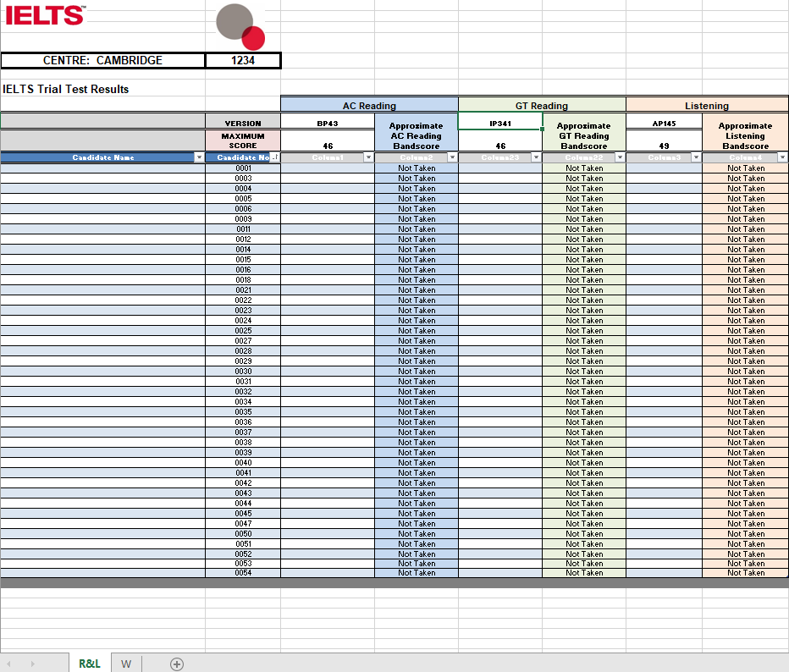
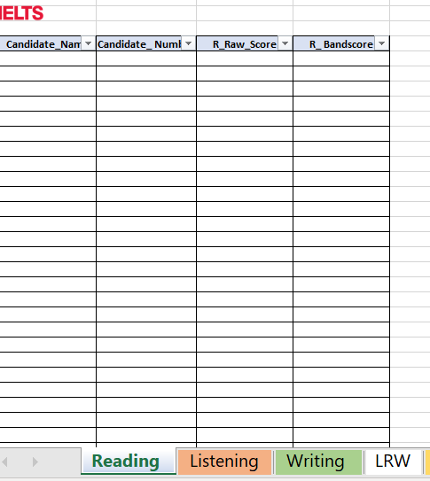
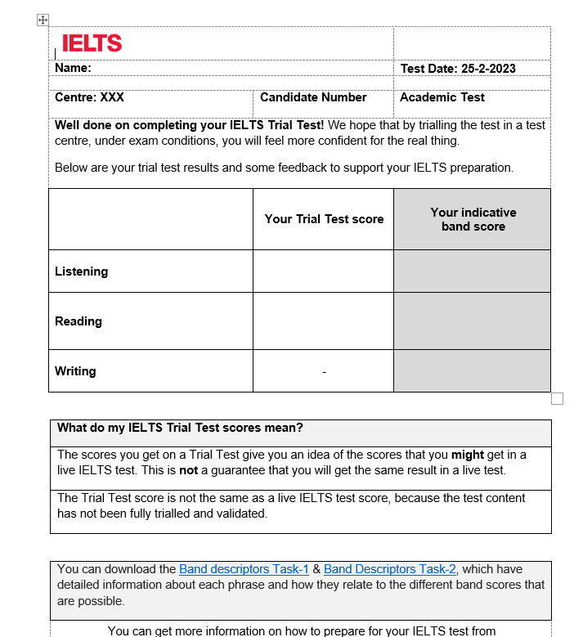
Sending Scores to Test Takers
2
Results file from Cambridge English, there will be 2 separate tabs for R&L and W scores labeled as:
  R&L
  W
TC receives from the Trial Test Project team.
  Trial Test Scores Template
  IELTS Trial Test Indicative Scores- Template

Slide 3
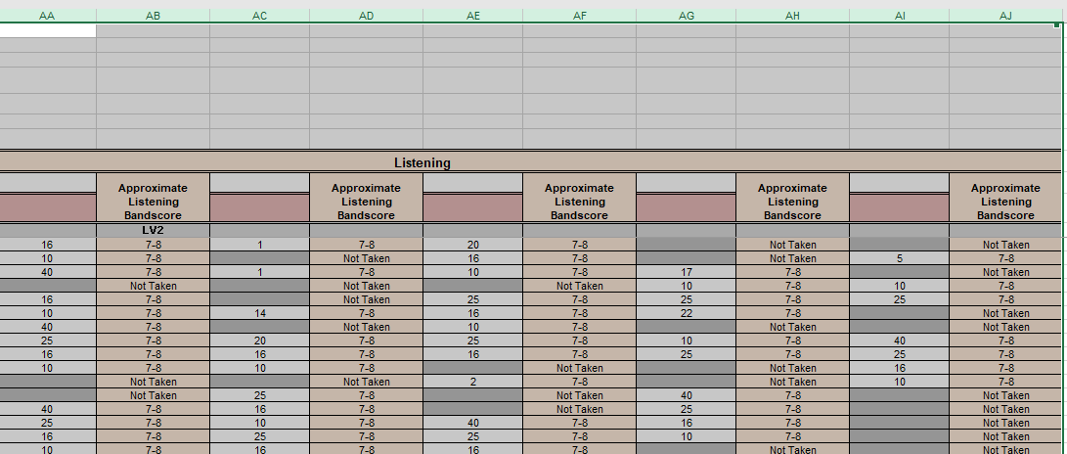
There will be multiple versions of Reading, Listening and writing for each module.
Label each version as RV1, RV2…LV1, LV2… & W1, W2…

Slide 4
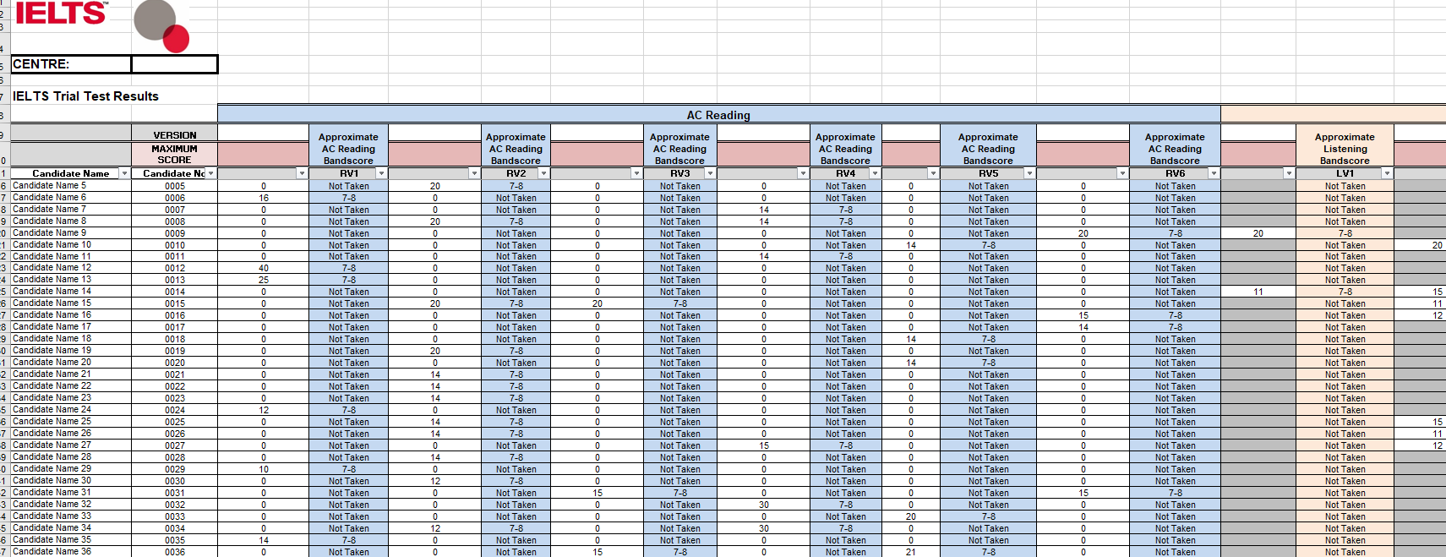
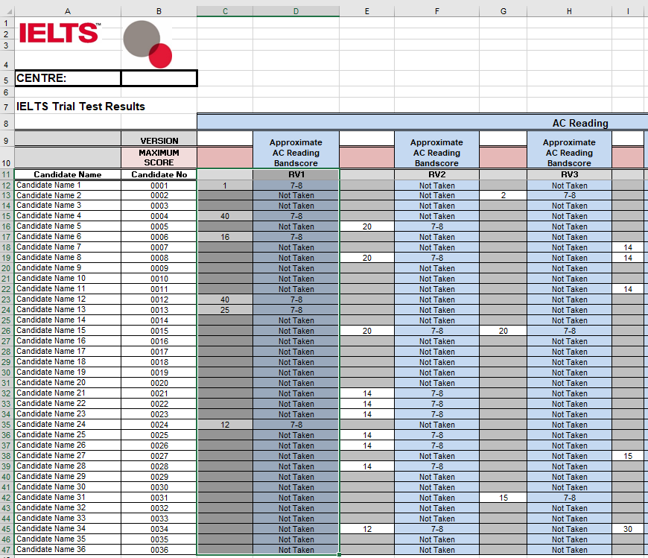
Apply filters to RL & W results returned by Cambridge English (in their respective tabs while cleansing the data)
TCs has to do AC & GT results separately
Select each version separately to filter
For example: Select Row 11 C to D and filter

Slide 5
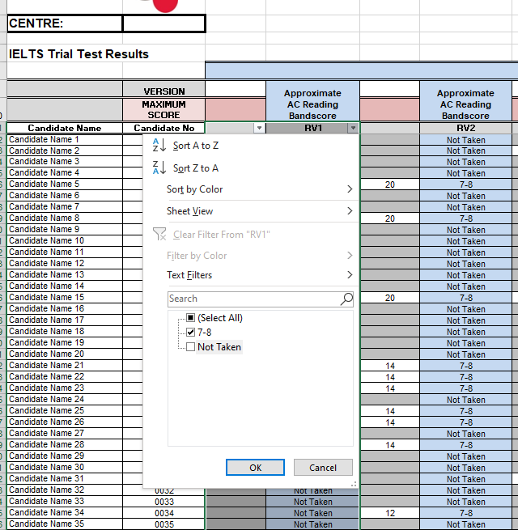
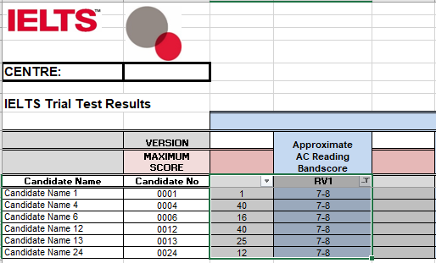
Filter the score of each version:
For example filter V1 (Reading Raw scores & App Reading scores )
Unselect not taken
Now copy Candidate Name & Candidate No and V1 to Trial Test Scores sheet

Slide 6
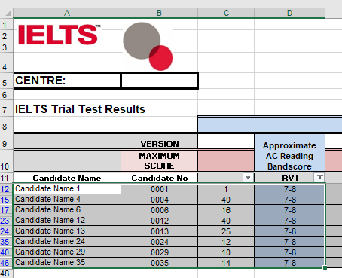
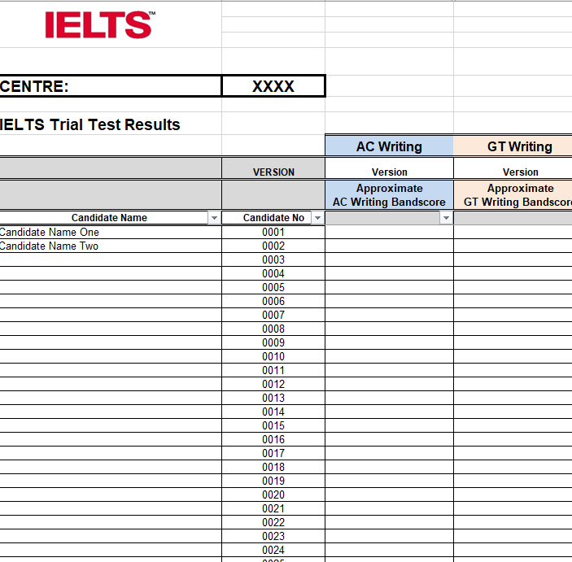
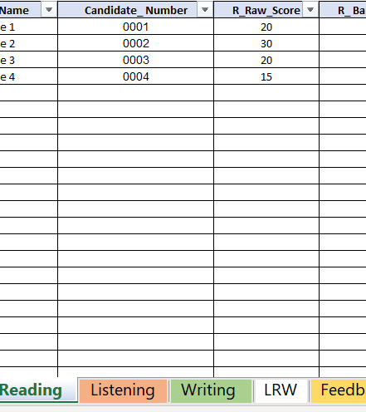
Now copy Candidate Name & Candidate No and V1 Row 11 and column A to D
Paste copied scores to Trial Test Scores template ( template provided by Cambridge)
Repeat the process until all versions of R & L are copied to Trial Test Scores in their individual worksheets.
Repeat the same process for the W score tab and apply filters like LR to separate scores across multiple versions for writing scores.

Slide 7
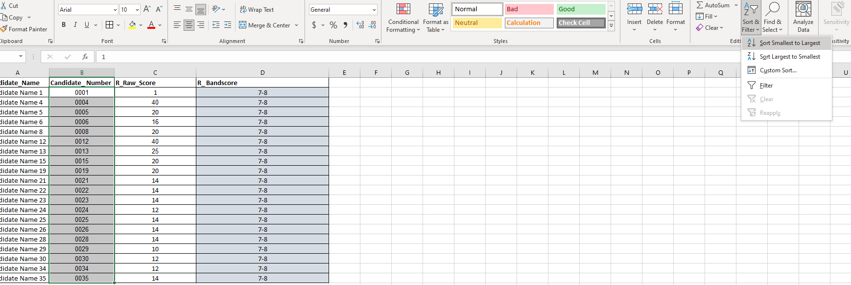
Tip: Ensure scores from all versions of each test component are copied to trial test scores template
Once scores are copied onto trial test scores template, sort them candidate numbers from smallest to largest for each worksheet

Slide 8
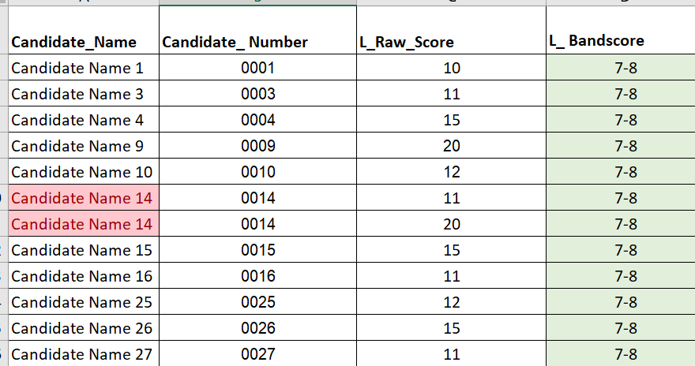
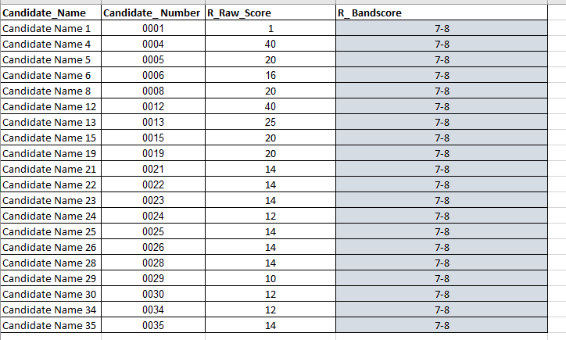
Delete if you have any duplicates

Slide 9
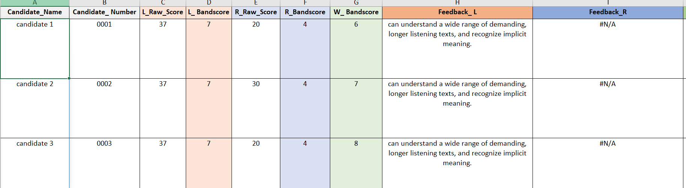
Once LRW Raw scores and bandscores are copied it will automatically populate the Feedback Tab

Slide 10
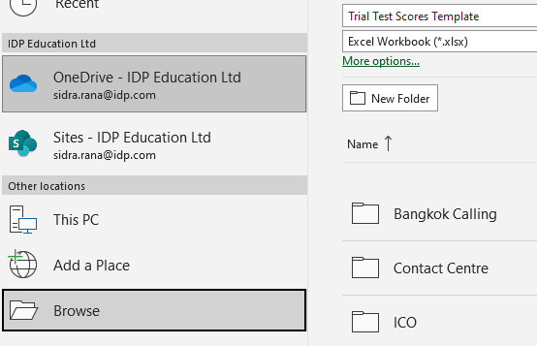
Mail Merge
Trial Test Score Spreadsheet Click on File
Save a copy
Click browse and save file.

Slide 11
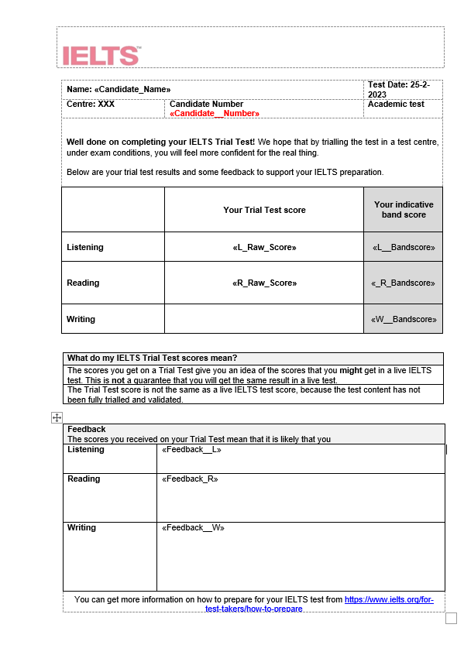
Open your word file (IELTS Trial Test Indicative Scores- Template)
Manually fill out Test Version & Test Date fields

Slide 12
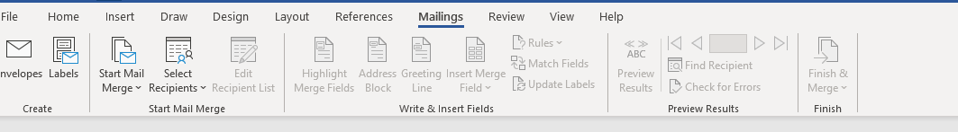
Now in IELTS Trial Test Indicative Scores- Template click on mailings.

Slide 13
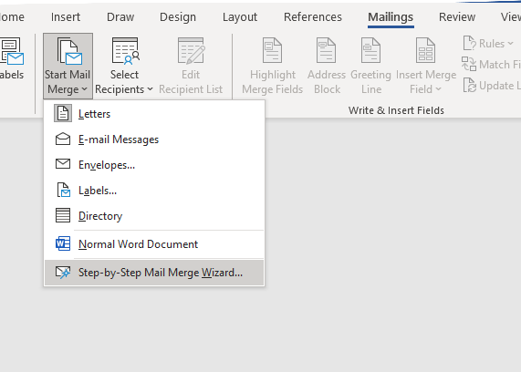
Click on Start Mail Merge- a dropdown menu will pop up.
Click on step-by-step mail merger wizard

Slide 14
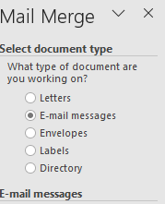
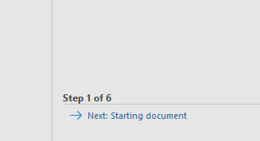
Make sure document type is a letter.
Click on next on step1 of 6 and follow these steps.

Slide 15
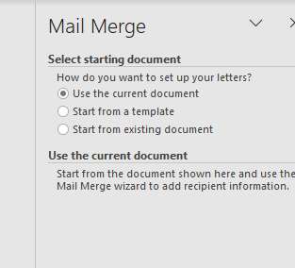
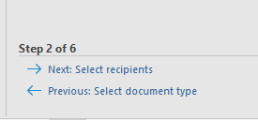
Select starting document “use the current document” (pre-set in the template).
Click on step: 2
Next select recipients

Slide 16
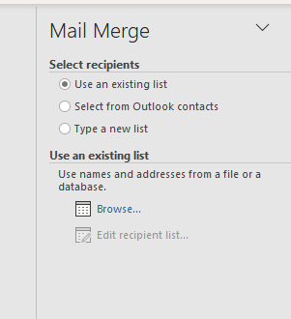

Use the existing list
Click on browse and attach your save excel score file.

Slide 17
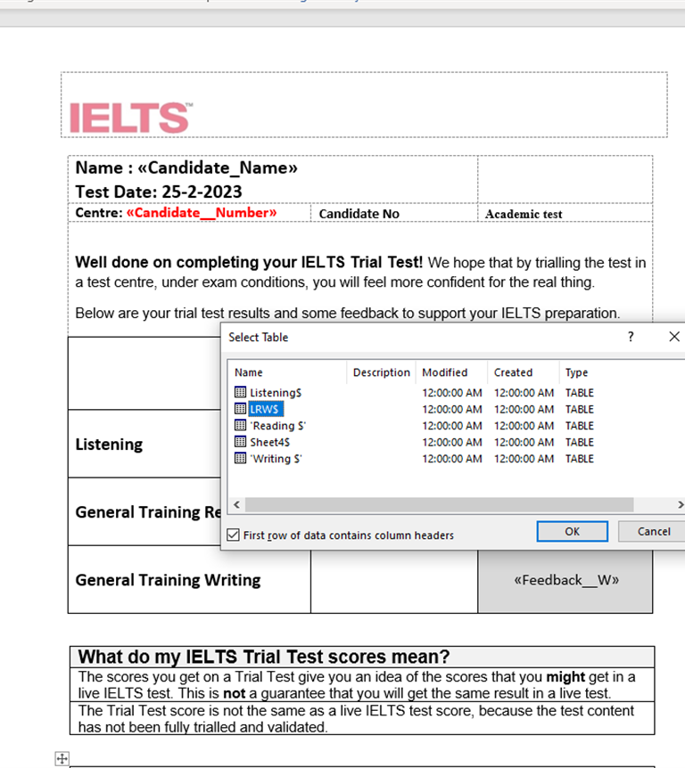
System will confirm worksheet for mail merge- select LRW and proceed.

Slide 18
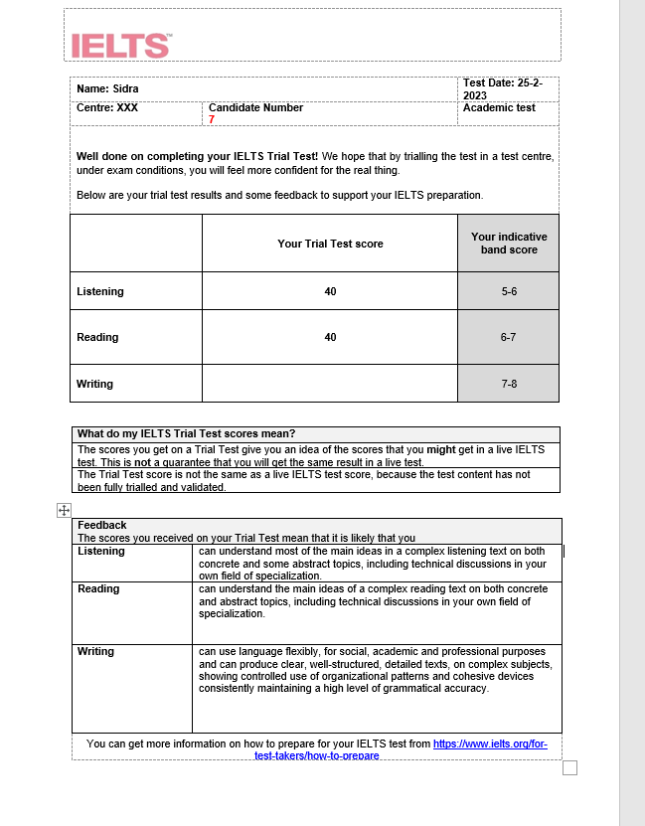
Preview the recipients and click on finish &merge.
Ensure candidate scores are matching.
Click on finish merge

Slide 19
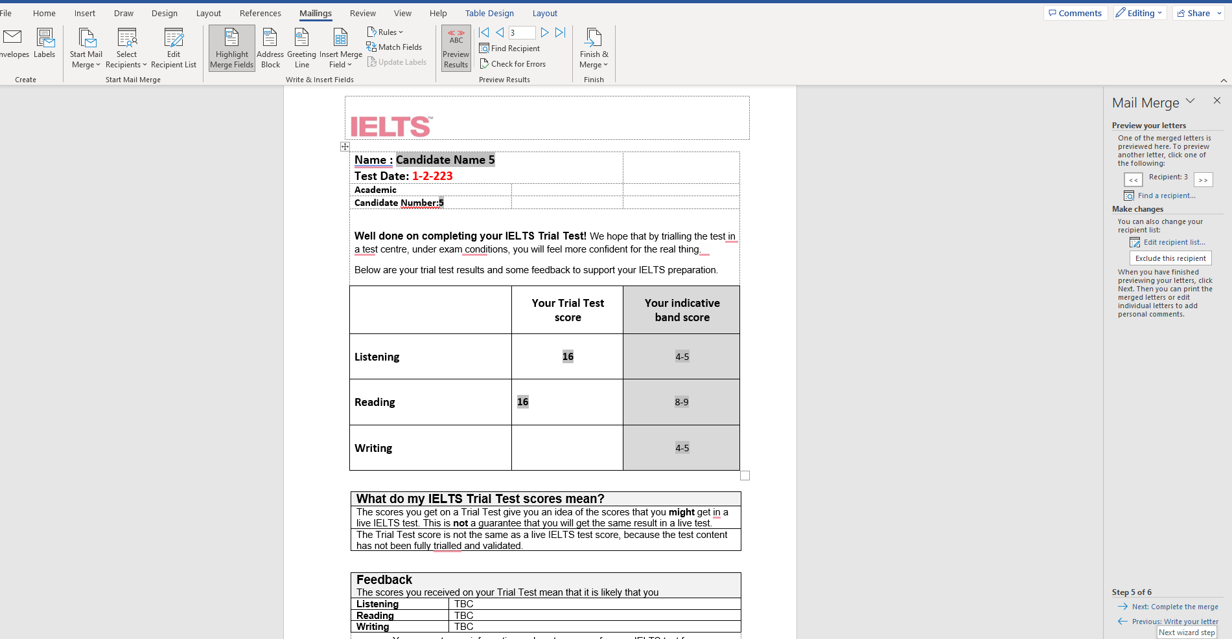
Click on Complete Merge

Slide 20
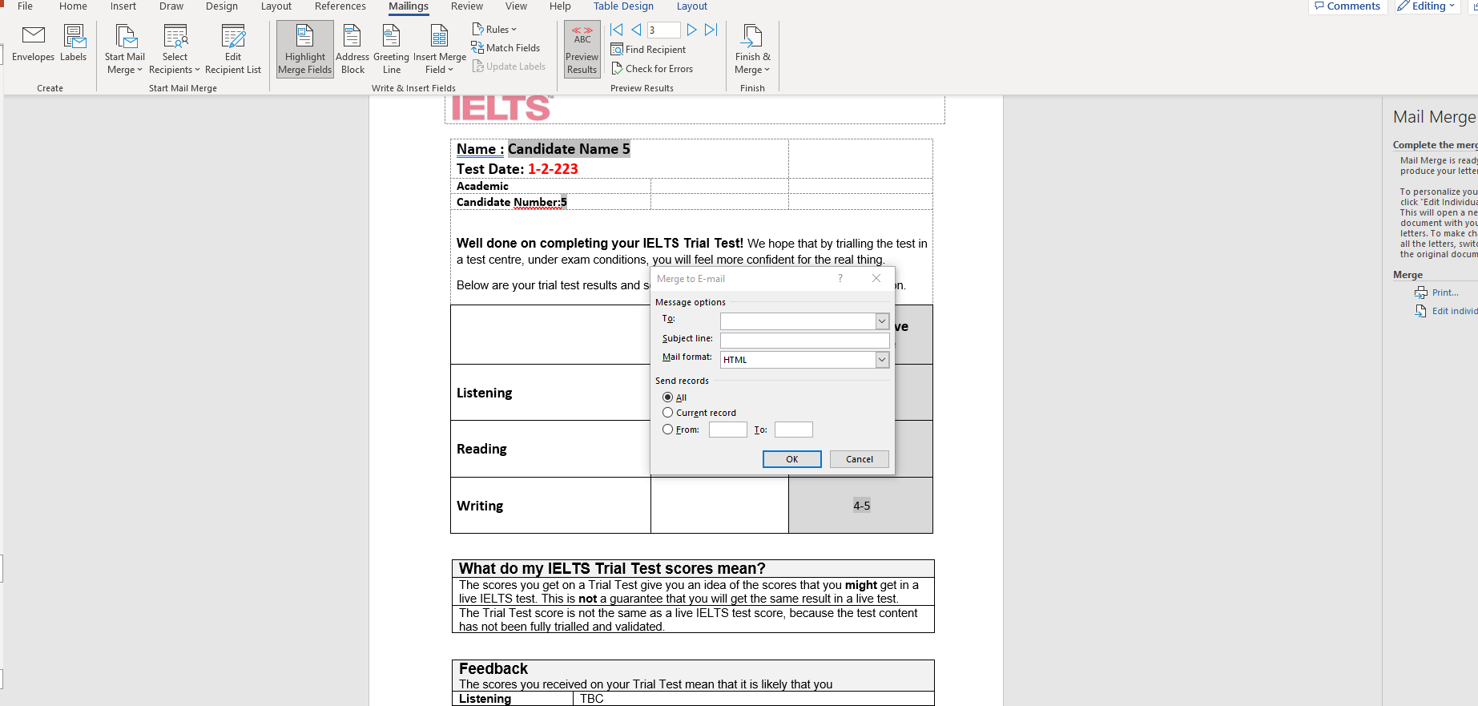
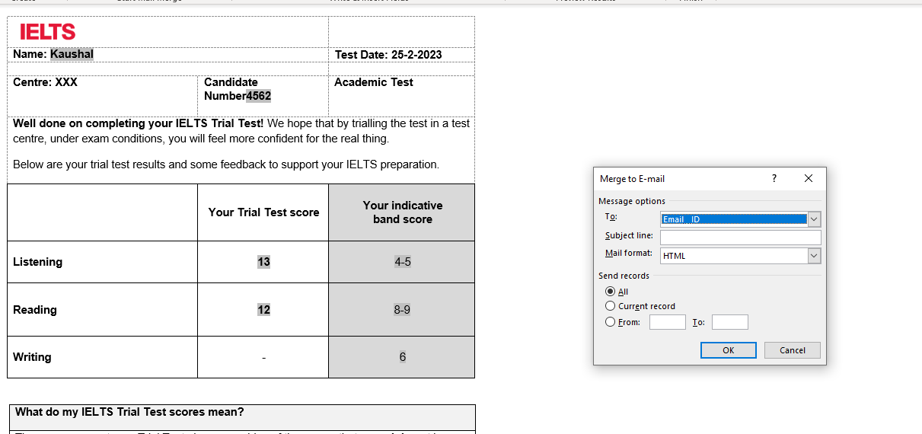
Click on send Email Message from the drop down in “to:
Select Email _ID from the drop-down menu.
Add Subject line:

Slide 21
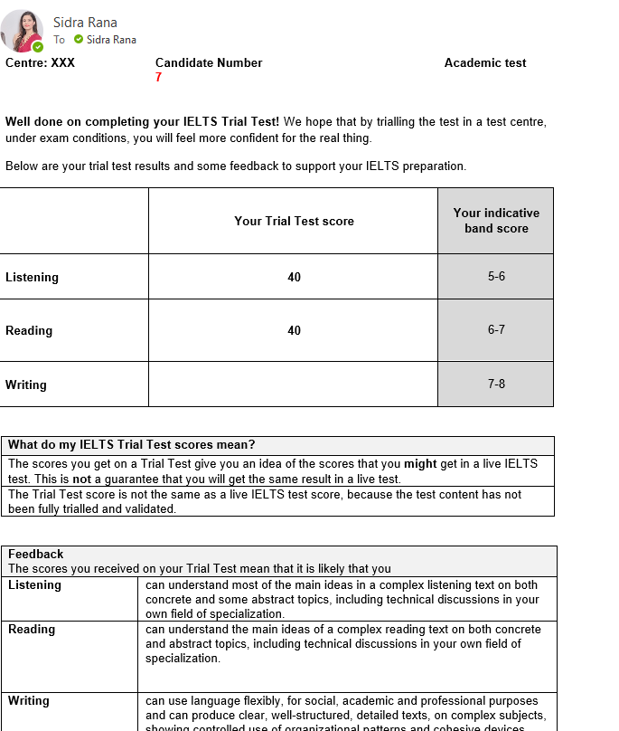
Candidate will receive their indicative band scores – Example

